Slide 1
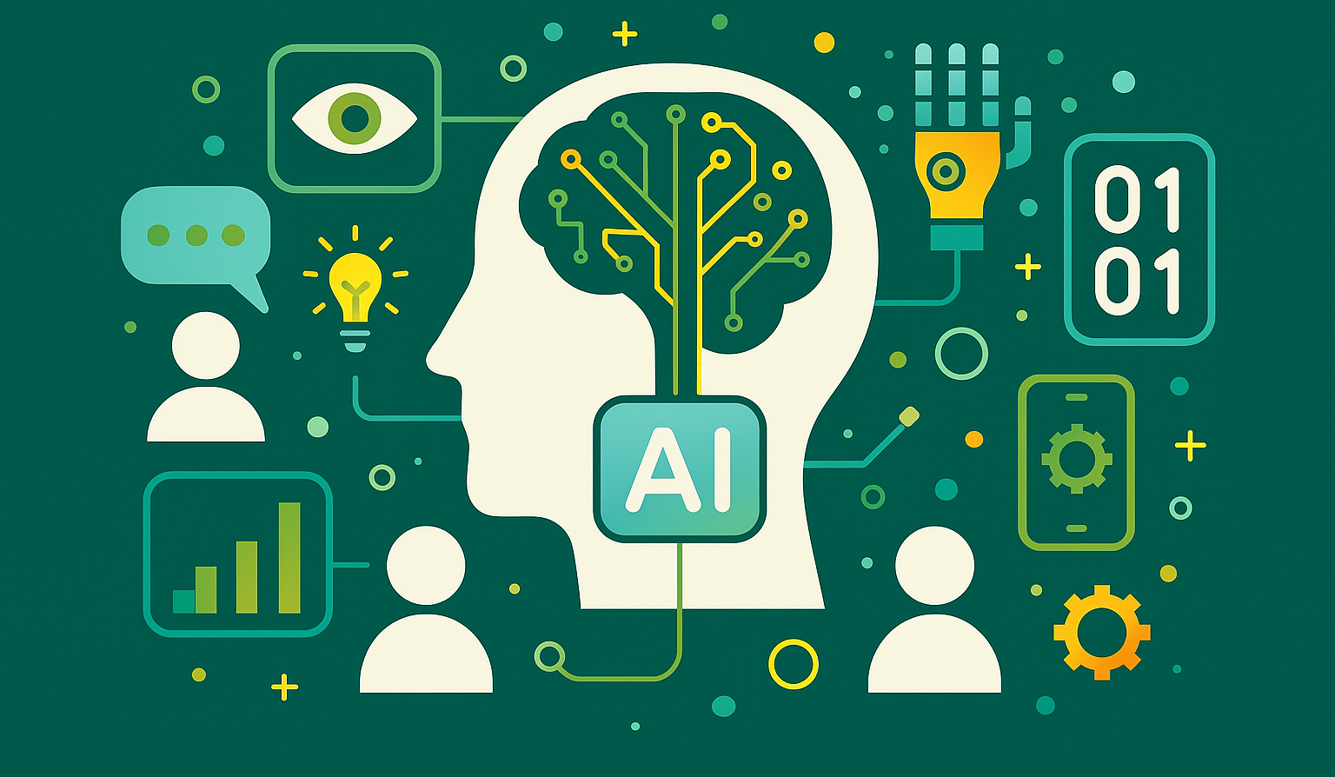
Machine Learning
Dr Ibrahim Alsaggaf

Slide 2
Licence Disclaimer
This document is distributed under the terms of the GNU General Public Licence, Version 3, dated 29 June 2007. It is intended to promote freedom to use, study, modify, and share the content herein, in accordance with the principles of free and open-source documentation. By accessing, reproducing, or modifying this document, you agree to comply with the conditions set forth in the GNU GPL v3. A full copy of the licence is available at https://www.gnu.org/licenses/gpl-3.0.html.
This licence applies to the document as a whole, including any derivative works, unless otherwise stated. No warranties are provided, and the document is offered “as-is” without liability for its use or interpretation.
Attribution Requirement
When using, sharing, or adapting this document for any individual, group, or organisation, proper citation of the original author is required. Please cite as follows:
Alsaggaf, I. (2025) Introduction to Artificial Intelligence. Available at: https://github.com/ibrahimsaggaf/Introduction-to-Artificial-Intelligence (Accessed: [insert date]).

Slide 3
Content
Supervised learning
Unsupervised learning
Self-supervised learning
Reinforcement learning
Transfer learning
Q&A
Lab session: Implementing two types of learning:
Supervised learning : Binary classification task
Unsupervised learning: Clustering task

Slide 4
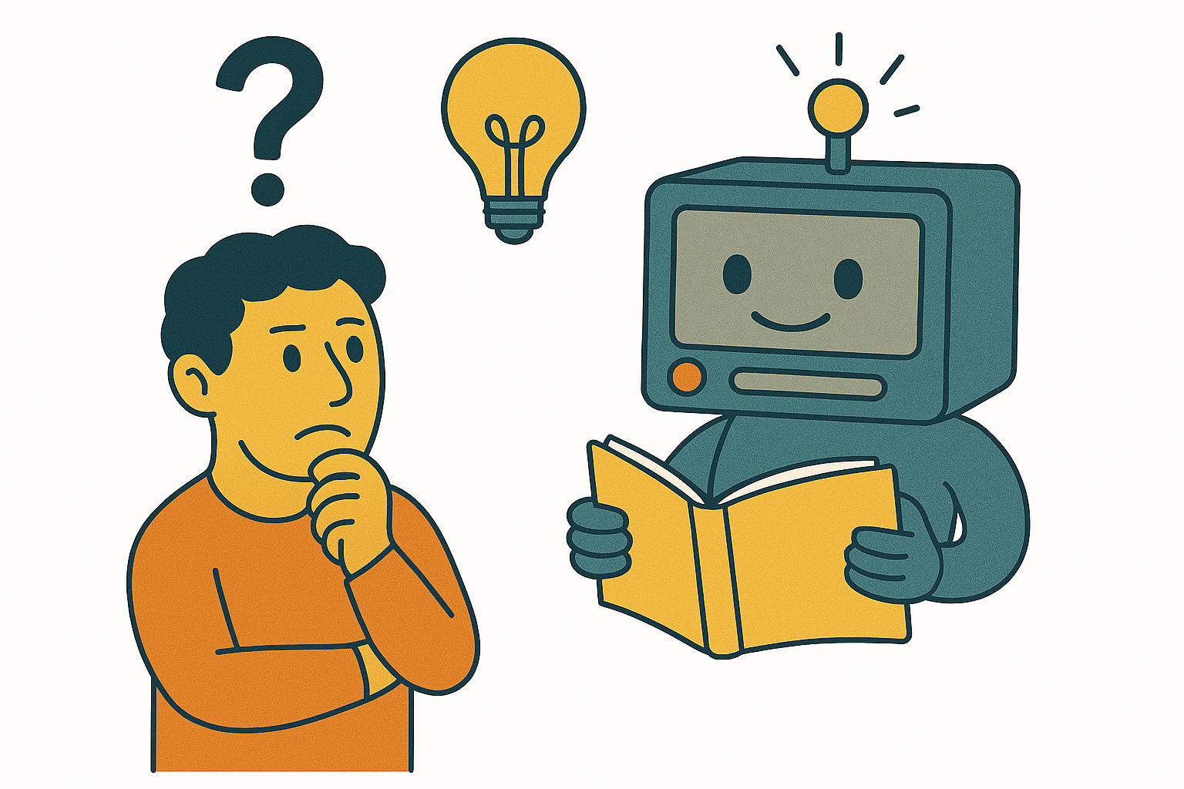
Can a machine really learn?
Generated using https://copilot.microsoft.com

Slide 5
Machines are good with processing instructions
Instructions
Assembly code
Binary
machine code
What is 1 + 1
2

Slide 6
Notations
Type | Colour | Size | Weight | Price
Chair | Brown | 20x20x40 m³ | 1.2 KG | 200
Couch | Blue | 40x40x40 m³ | 25 KG | 1000
Bed | White | 180x90x60 | 40KG | ?

Slide 7
Notations
Features (X)
Target/label (y)
Type | Colour | Size | Weight | Price
Chair | Brown | 20x20x40 m³ | 1.2 KG | 200
Couch | Blue | 40x40x40 m³ | 25 KG | 1000
Bed | White | 180x90x60 | 40KG | ?

Slide 8
Notations
Independent variables
Dependent variable
Features (X)
Target/label (y)
Type | Colour | Size | Weight | Price
Chair | Brown | 20x20x40 m³ | 1.2 KG | 200
Couch | Blue | 40x40x40 m³ | 25 KG | 1000
Bed | White | 180x90x60 | 40KG | ?

Slide 9
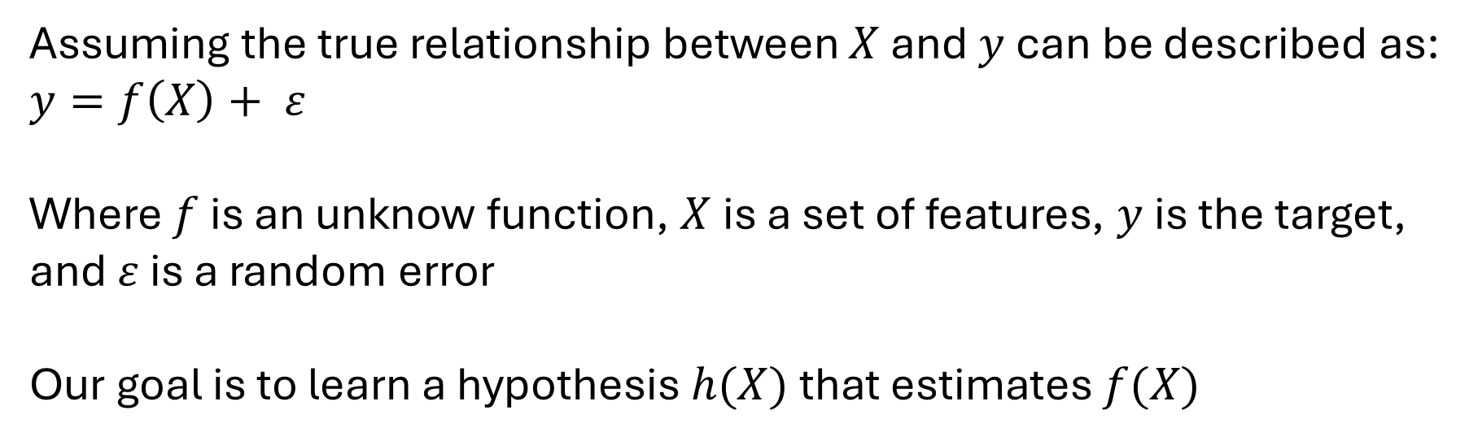
Notations
Assuming the true relationship between $X$ and $y$ can be described as:
$$y=f\left(X\right)+ ε$$
Where $f$ is an unknow function, $X$is a set of features, $y$ is the target, and $ε$ is a random error
Our goal is to learn a hypothesis $h(X)$ that estimates $f(X)$

Slide 10


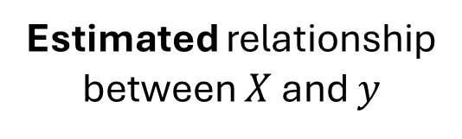
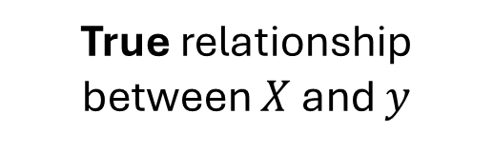
$f(X)$
$$h(X)$$
VS
True relationship
between $X$ and $y$
Estimated relationship
between $X$ and $y$
Real world
AI agent

Slide 11
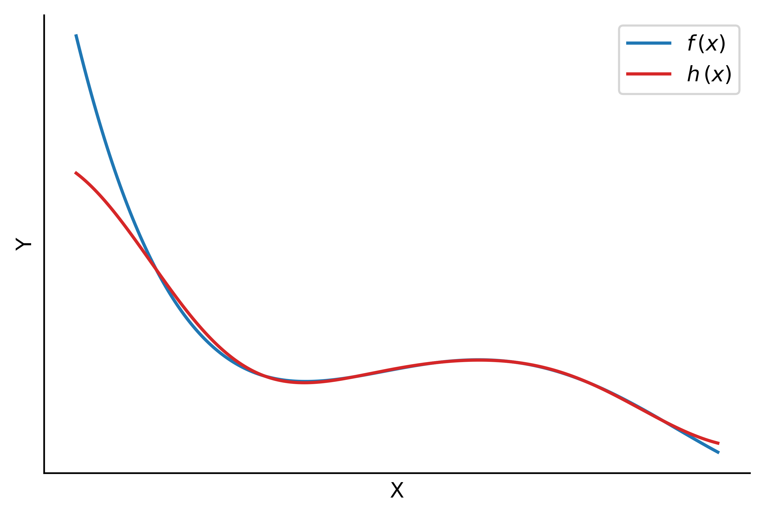
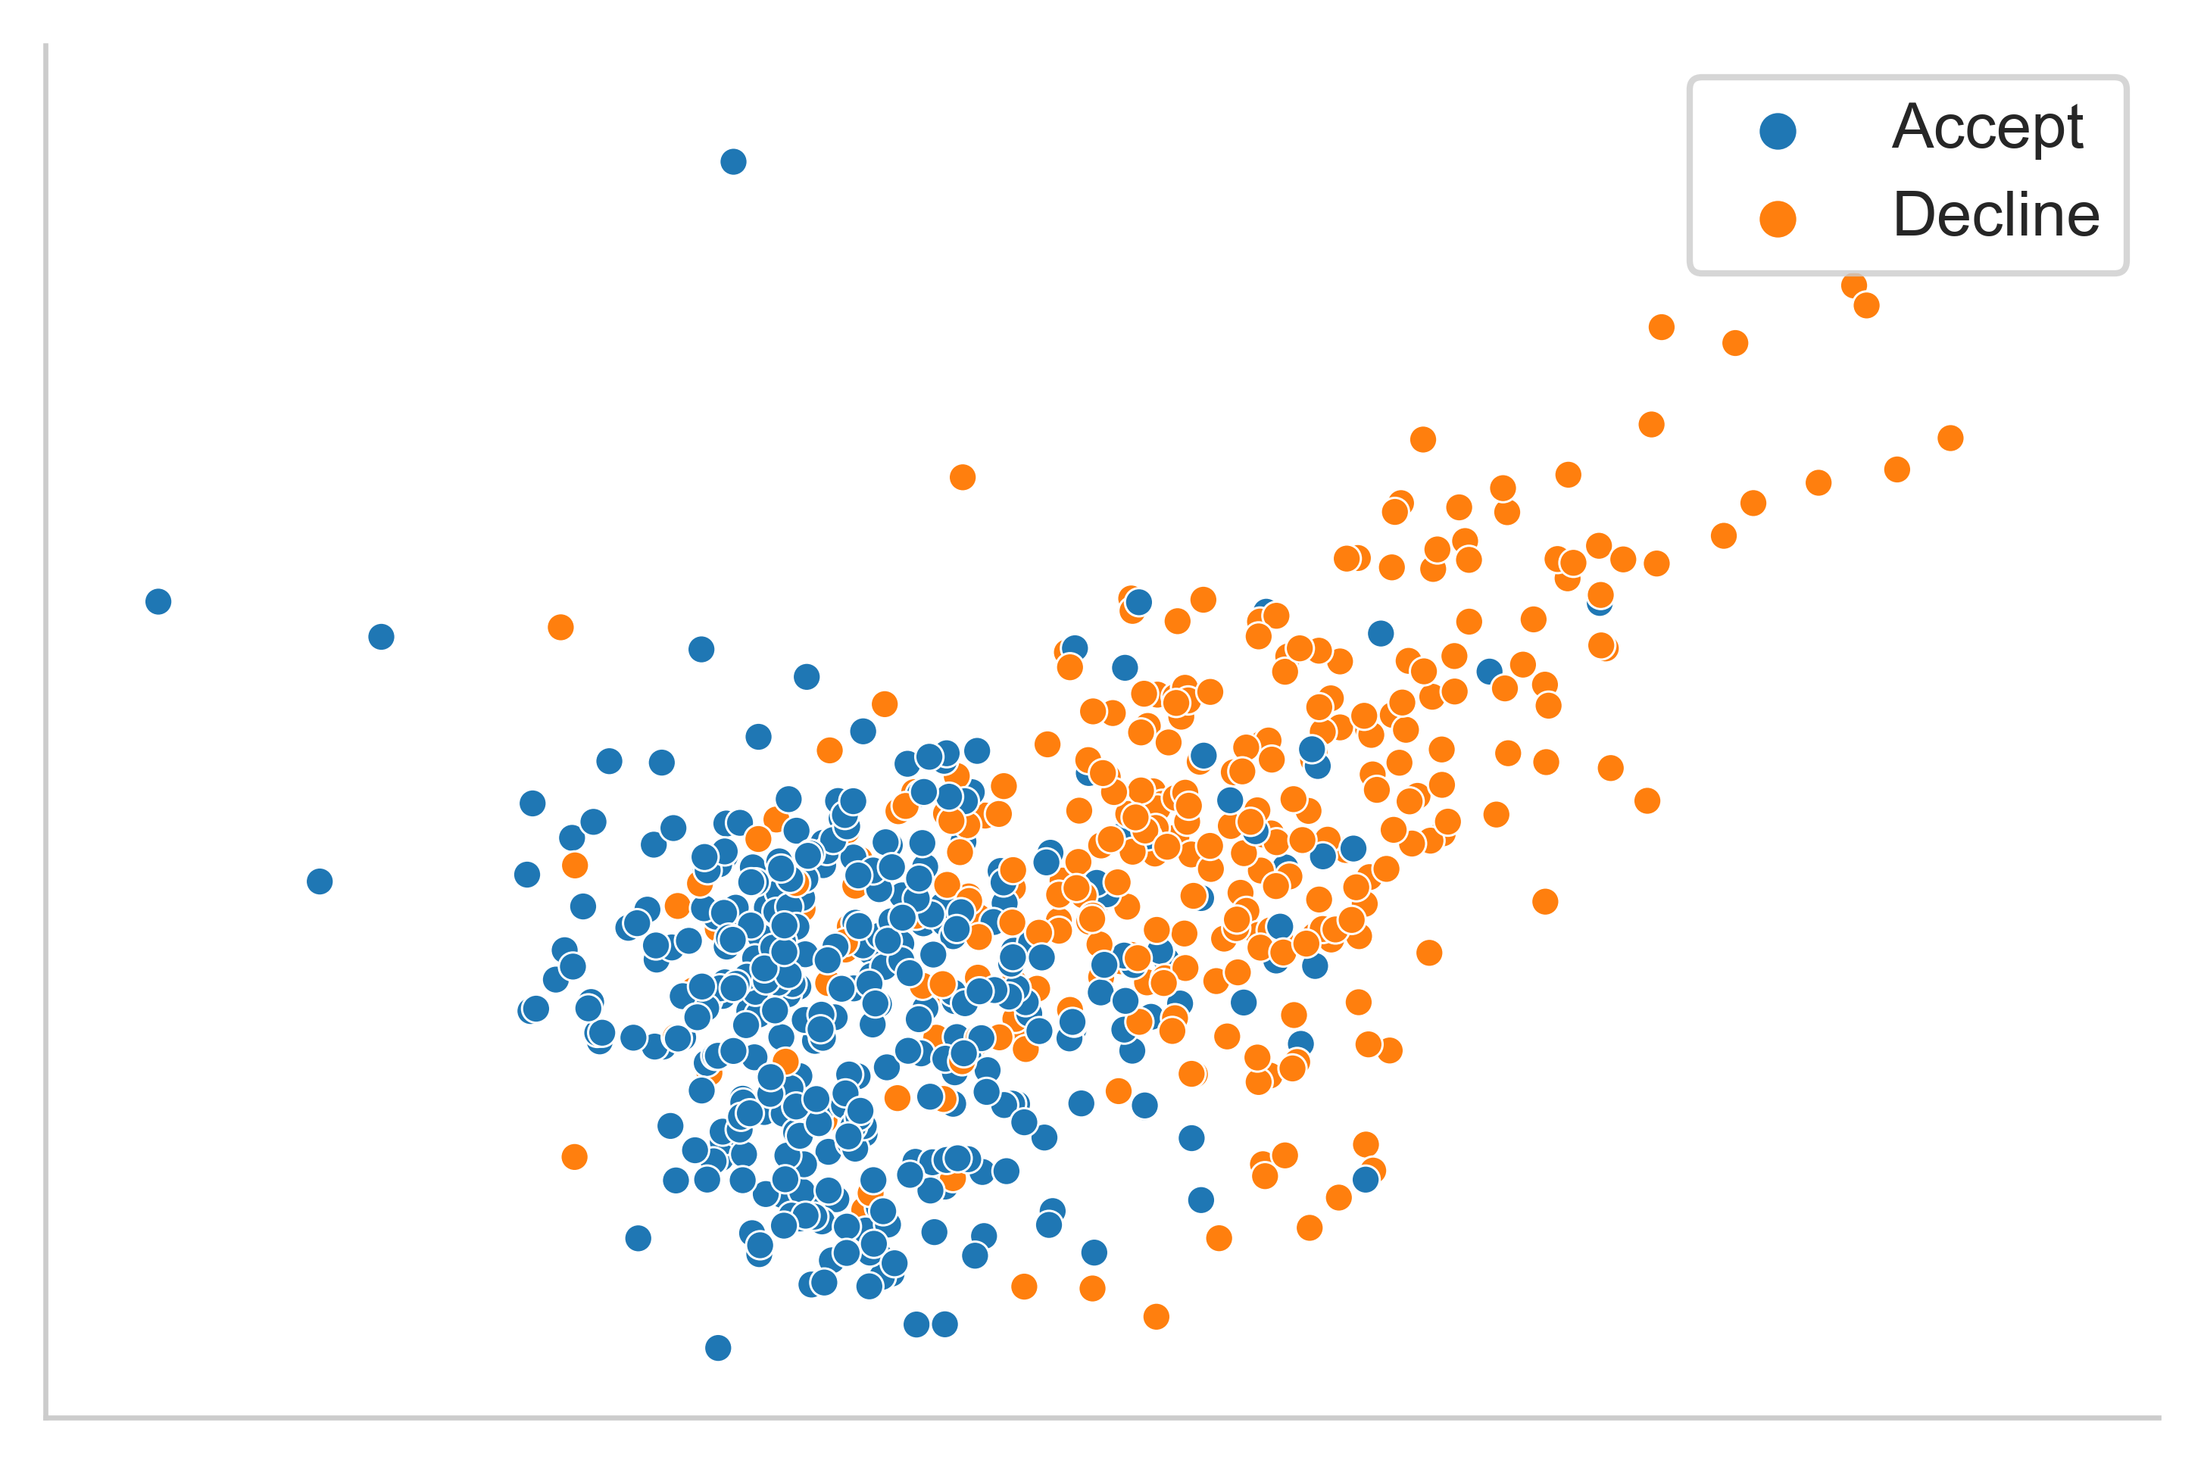
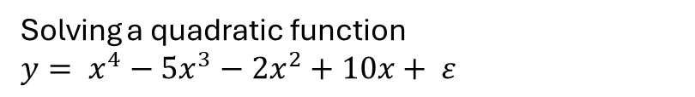
Supervised learning
Finding the optimal hypothesis $h\left(X\right)$ that best estimates the true relationship between $X$ and $y$
Solving a quadratic function
$$y= x^{4}−5x^{3}−2x^{2}+10x+ ε$$
Credit card applications
[Source] UCI Machine Learning Repository

Slide 12
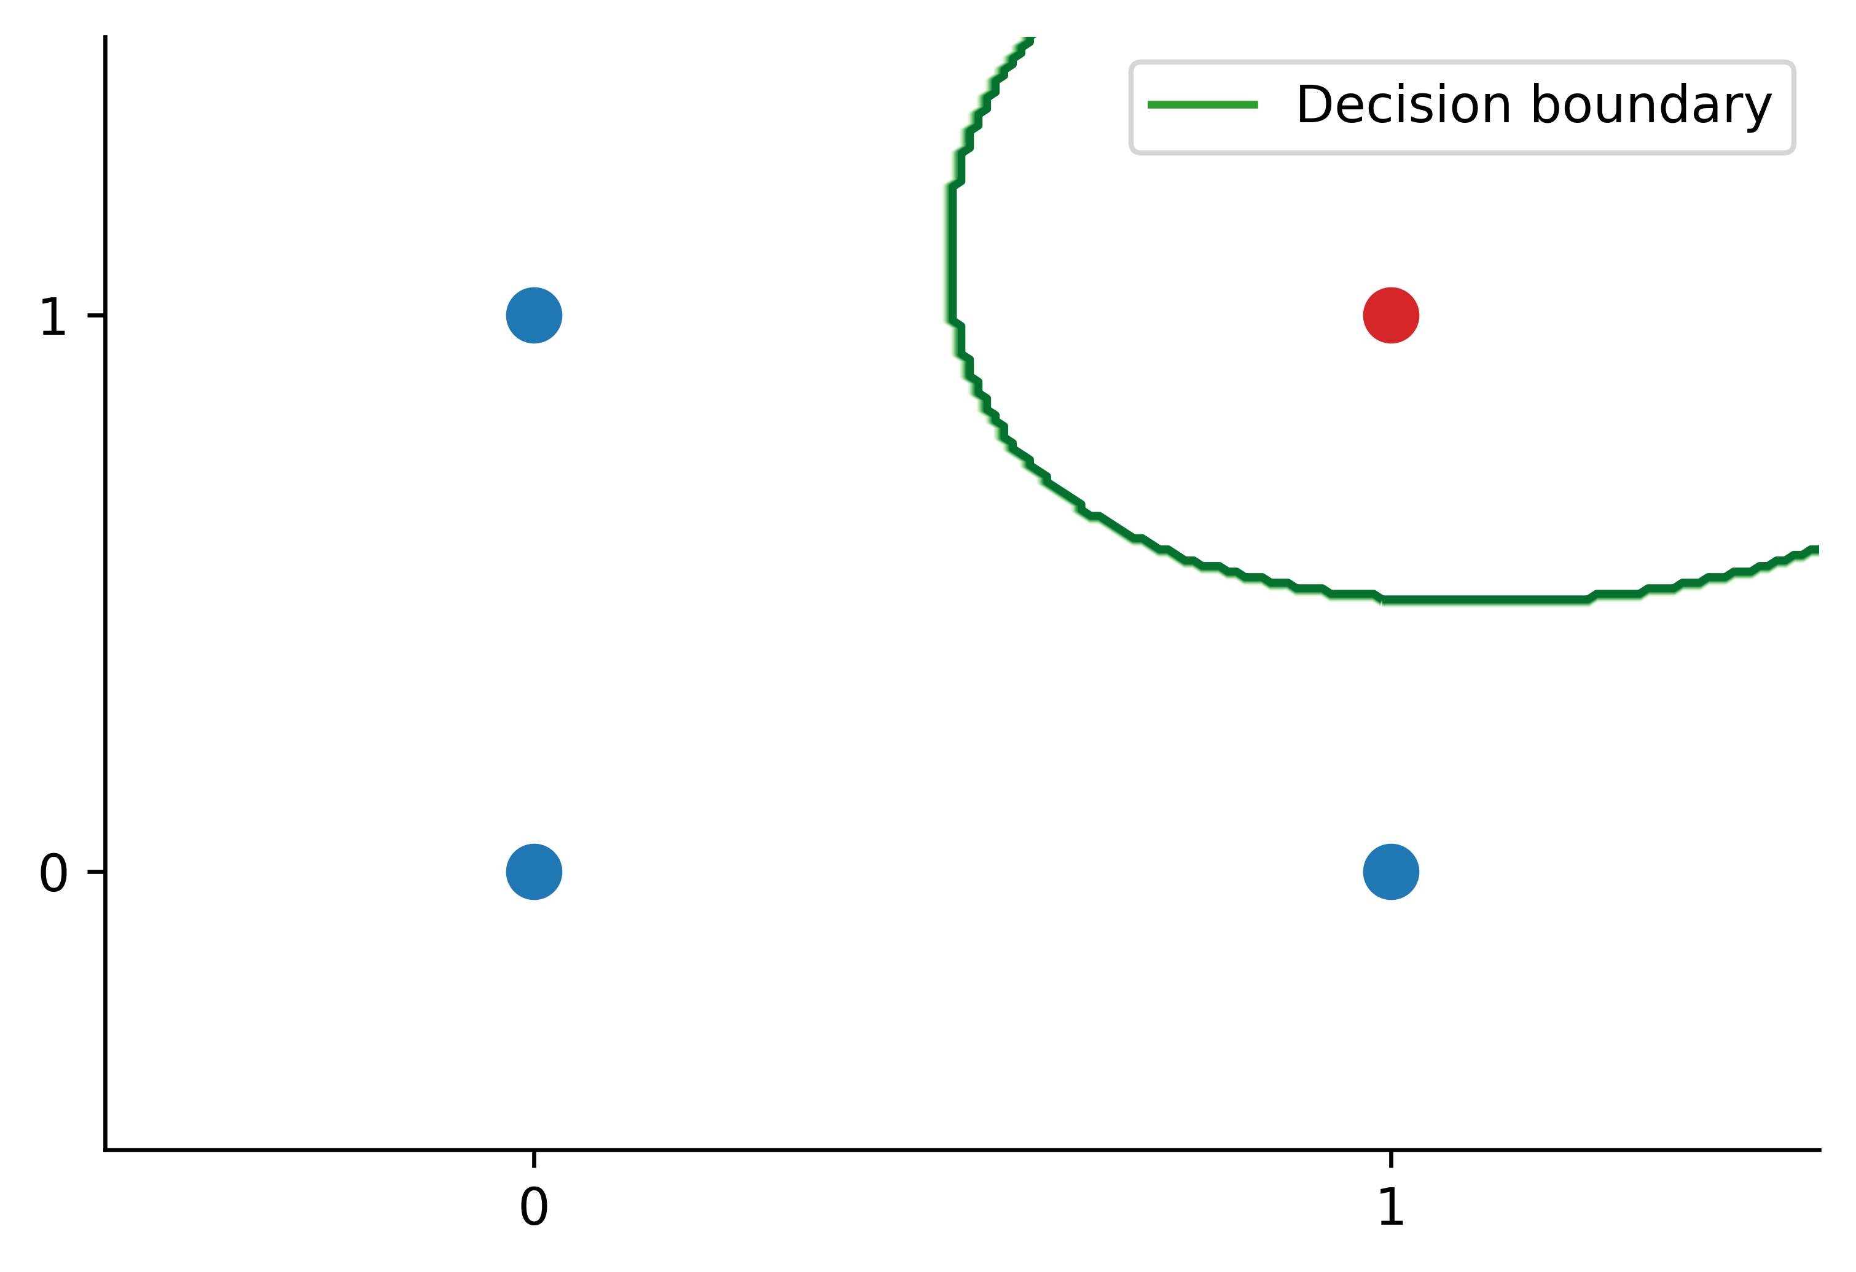
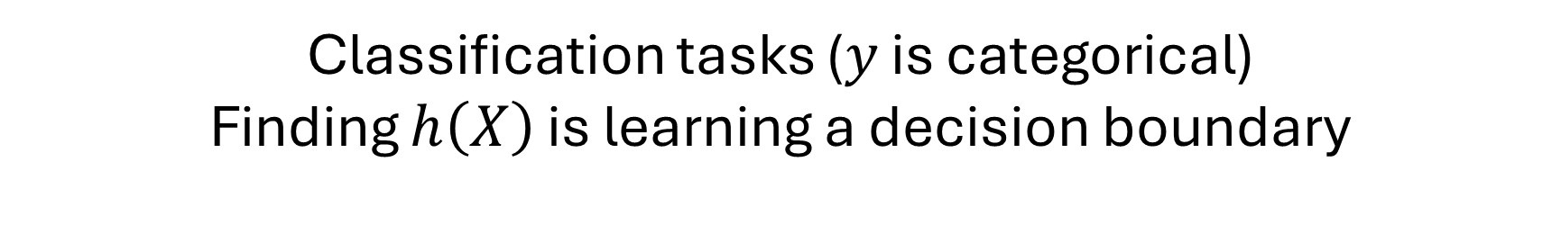
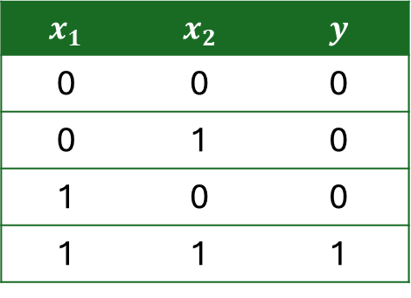
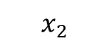
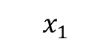
Supervised learning
Classification tasks ($y$ is categorical)
Finding $h\left(X\right)$ is learning a decision boundary
AND problem
$$x_{1}$$ | $$x_{2}$$ | $$y$$
0 | 0 | 0
0 | 1 | 0
1 | 0 | 0
1 | 1 | 1
$$x_{2}$$
$$x_{1}$$

Slide 13
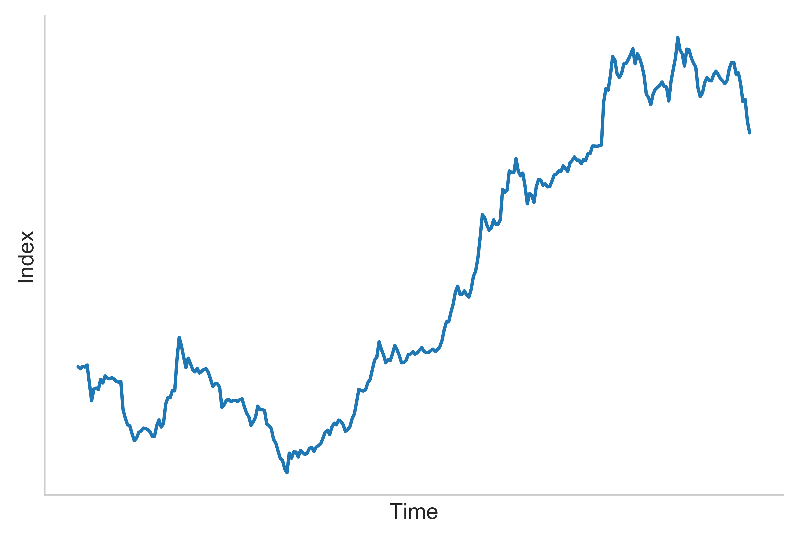
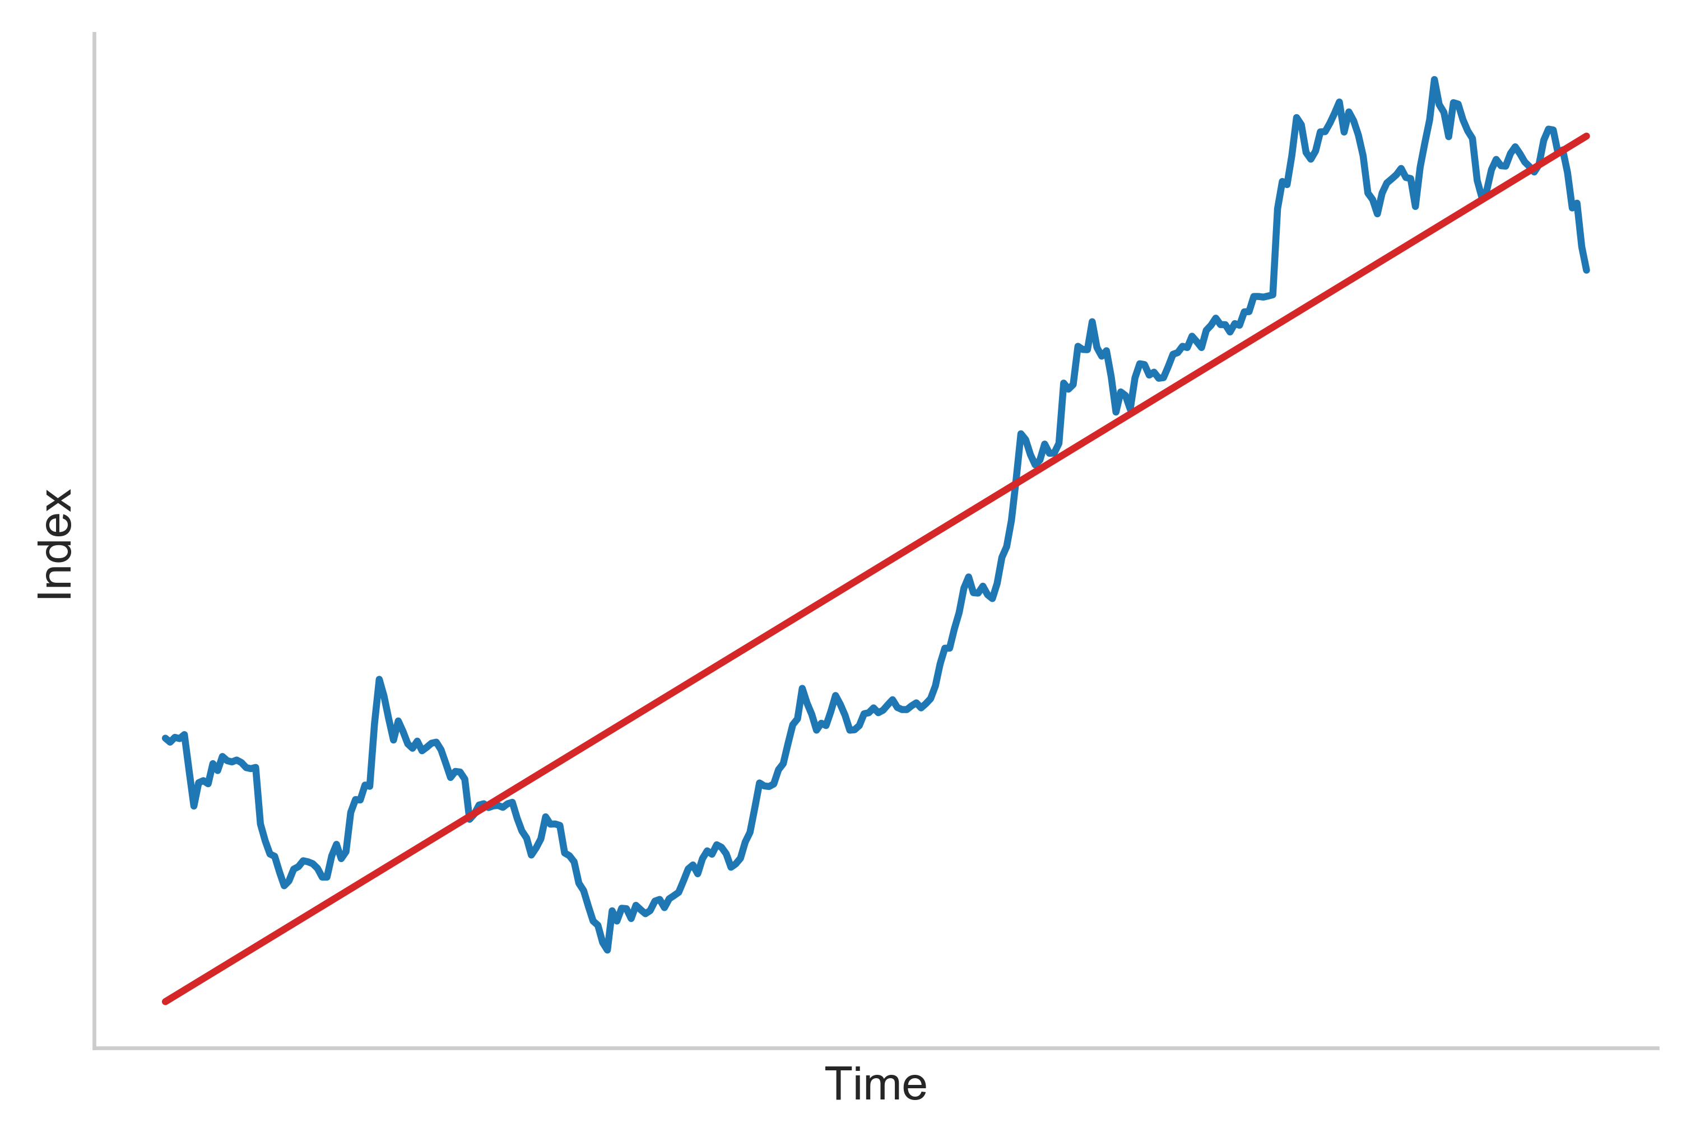
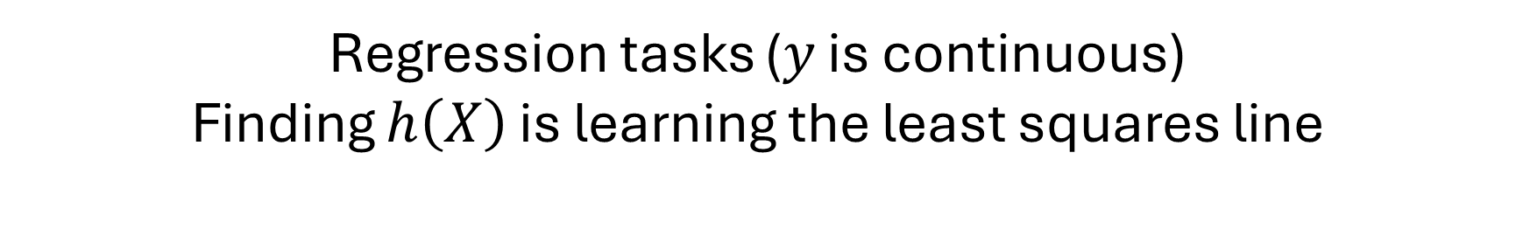
Supervised learning
Regression tasks ($y$ is continuous)
Finding $h\left(X\right)$ is learning the least squares line
Tadawul All Share Index (TASI) 1996 – 1997
[Source] Saudi Stock Exchange

Slide 14
Supervised learning
$y$ acts as a supervisor that tells us how good or bad is $h\left(X\right)$
$$y≈h\left(X\right)$$

Slide 15

Unsupervised learning
How to estimate $h\left(X\right)$ with the absence of $y$?
$$y≈h\left(X\right)$$

Slide 16

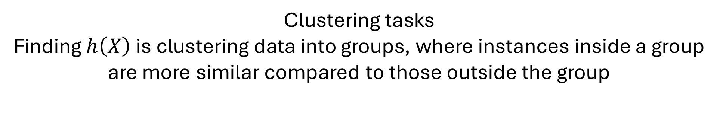
Unsupervised learning
Clustering tasks
Finding $h\left(X\right)$ is clustering data into groups, where instances inside a group are more similar compared to those outside the group
???
Diabetes diagnosis problem (17 features)
chol | hdl | ratio | age | height | weight | …
203 | 56 | 3.6 | 46 | 62 | 121 | …
165 | 24 | 6.9 | 29 | 64 | 218 | …
228 | 37 | 6.2 | 58 | 61 | 256 | …
… | … | … | … | … | … | …
Doctor
[Source] data.world catalog

Slide 17
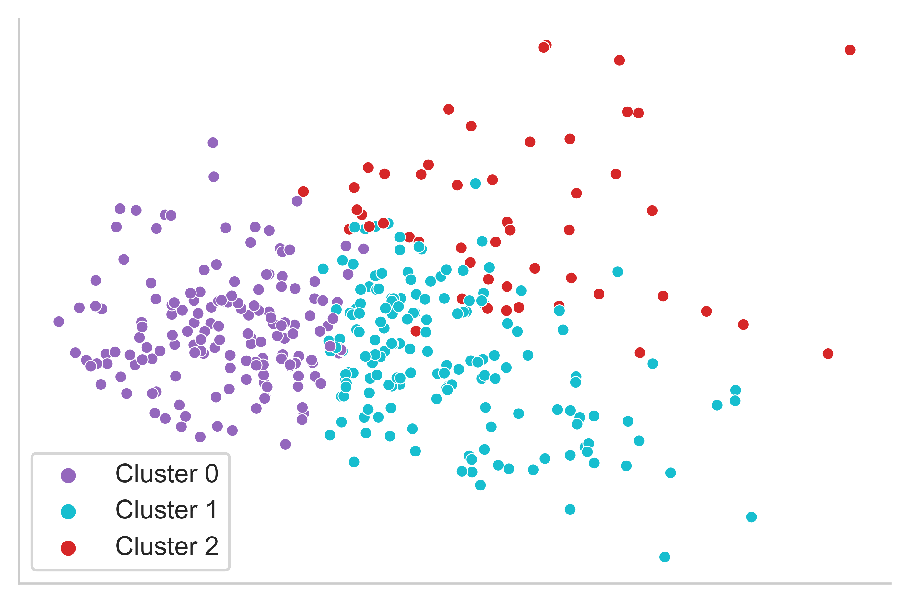
Unsupervised learning
Clustering tasks
Finding $h\left(X\right)$ is clustering data into groups, where instances inside a group are more similar compared to those outside the group
Diabetes diagnosis problem (17 feature)
chol | hdl | ratio | age | height | weight | …
203 | 56 | 3.6 | 46 | 62 | 121 | …
165 | 24 | 6.9 | 29 | 64 | 218 | …
228 | 37 | 6.2 | 58 | 61 | 256 | …
… | … | … | … | … | … | …
[Source] data.world catalog

Slide 18
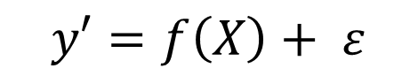
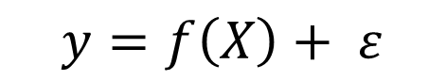
Self-supervised learning
Self-supervised Supervised
$$y′=f\left(X\right)+ ε$$
VS
$$y=f\left(X\right)+ ε$$
Pseudo-label True label
Pseudo-label $y′$ is created using $X$

Slide 19
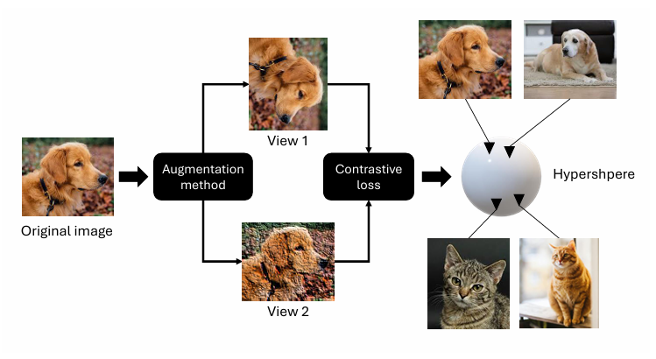
Self-supervised learning
Contrastive learning
Widely-adopted self-supervised learning algorithm
Learning a new representation of the data, where similar instances are pulled closer and dissimilar instances are pushed further
https://eprints.bbk.ac.uk/id/eprint/56689/

Slide 20

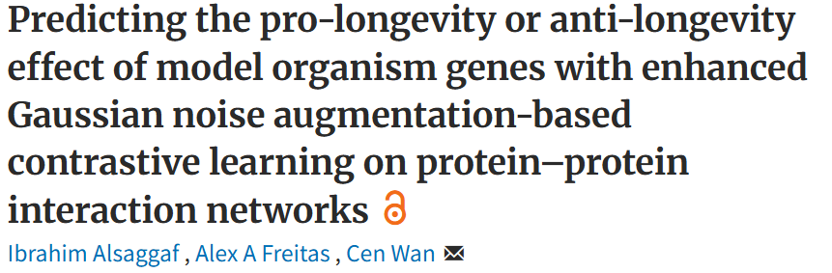
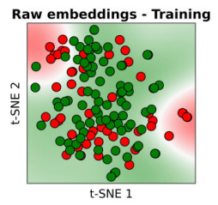
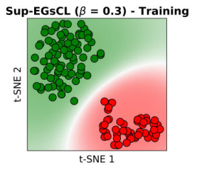
Self-supervised learning
JOURNAL ARTICLE
Before
After
Contrastive
learning
https://academic.oup.com/nargab/article/6/4/lqae153/7912061

Slide 21
Reinforcement learning
An AI agent
taking actions
in a dynamic environment
to maximise a reward

Slide 22
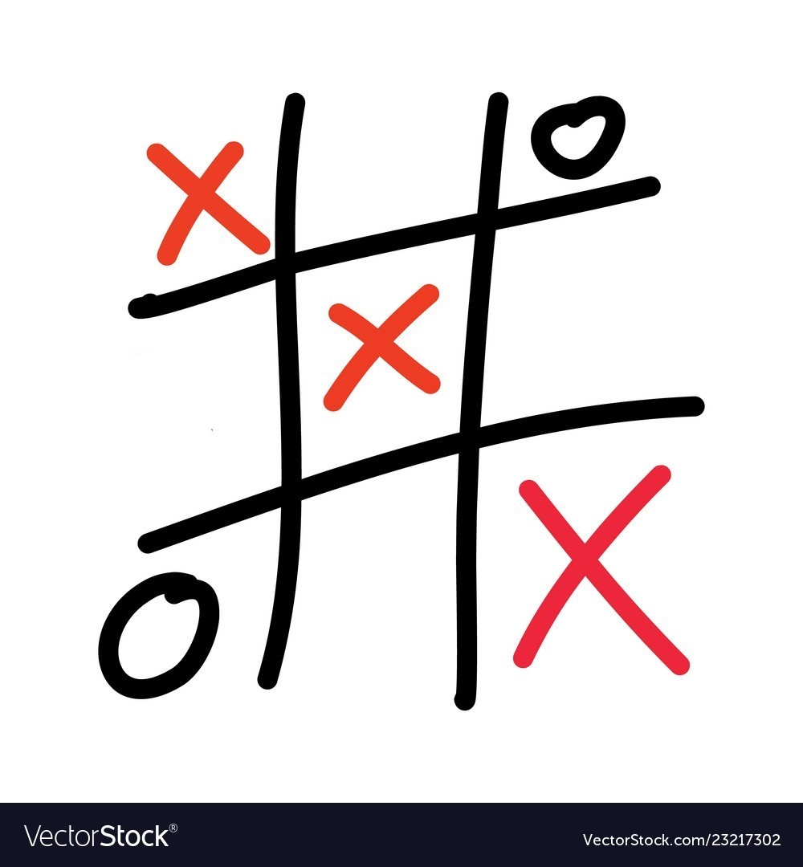


Reinforcement learning
Environment
Action
State
Reward
Gamer
AI agent

Slide 23
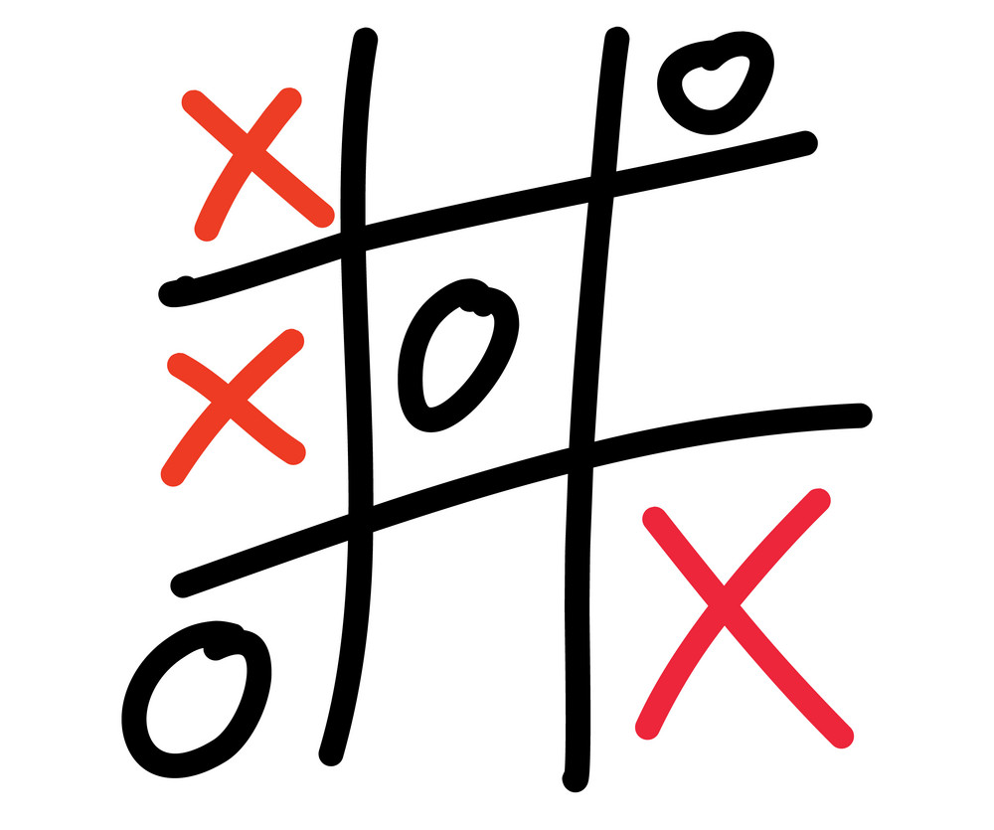
Reinforcement learning
Environment
Action
State
Penalty
Gamer
AI agent

Slide 24
Reinforcement learning
Learning
Expert
Feedback
AI agent

Slide 25
Reinforcement learning
Learning
Policy
Feedback
AI agent

Slide 26
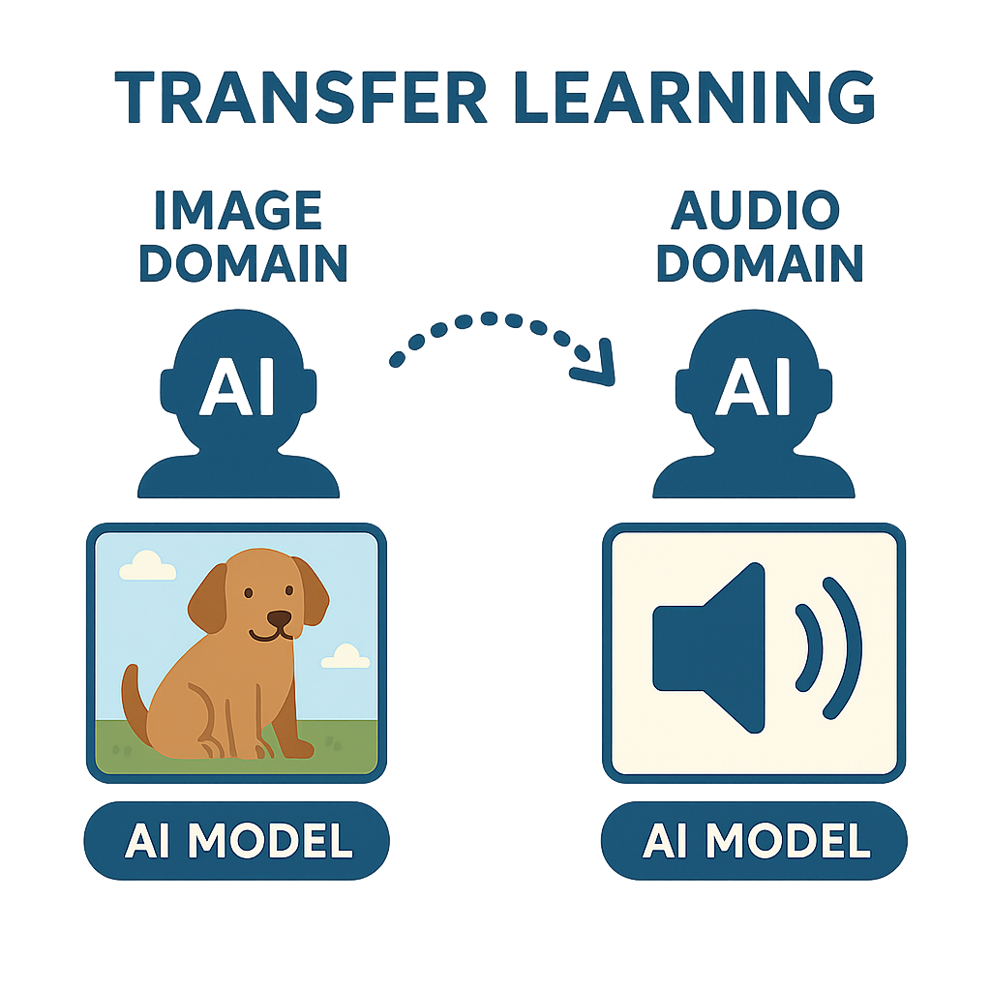
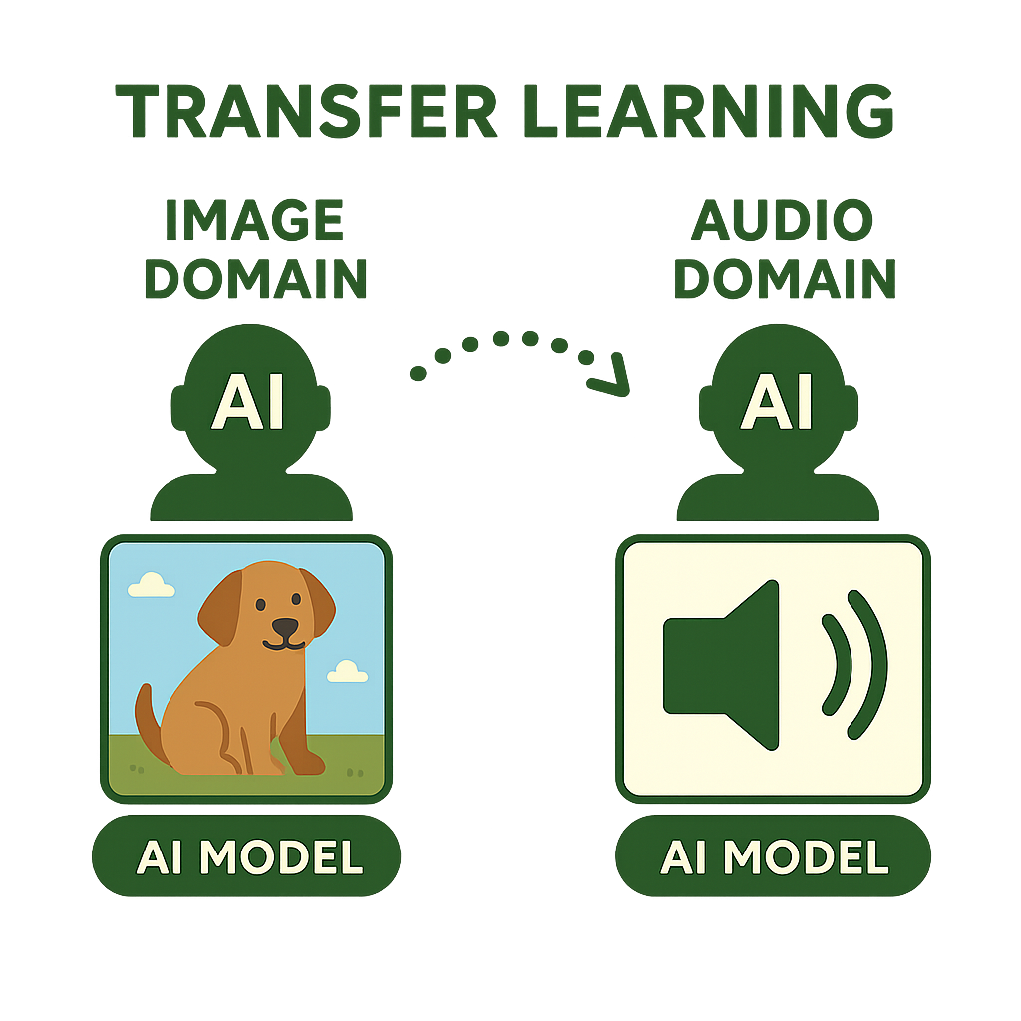
Transfer learning
Can an AI agent transfer knowledge from one domain to another?
Generated using https://copilot.microsoft.com

Slide 27

Transfer learning
Key success factor
Domain 1
Domain 1
General
images
classification
Disease
recognition
in X-rays
Domain similarity
Domain 1
Domain 1
General
images
classification
Negative
transfer
Object
detection
Domain dissimilarity

Slide 28
Q&A

Slide 29

Lab Time
Lab 3: Implementing two types of learning

Slide 30
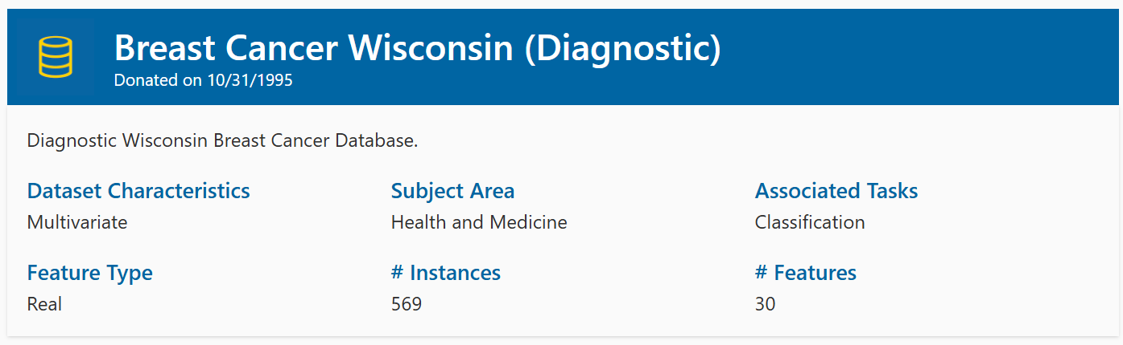
Lab 3: Dataset
Class distribution: 357 Benign (non-cancerous) and 212 Malignant (cancerous)

Slide 31
Step 1
Download the Lab3 directory from the GitHub repository https://github.com/ibrahimsaggaf/Introduction-to-Artificial-Intelligence
Open the Lab3 directory in Visual Studio Code.
The Lab3 directory contains 3 python files:
binary_classification.py
clustering.py
utils.py
Take your time examining the code in these files.

Slide 32
Step 2
Create and activate a virtual environment under the name “lab3_env” (see Lab 1)
Install the scikit-learn library inside the virtual environment
(see Lab 2)

Slide 33
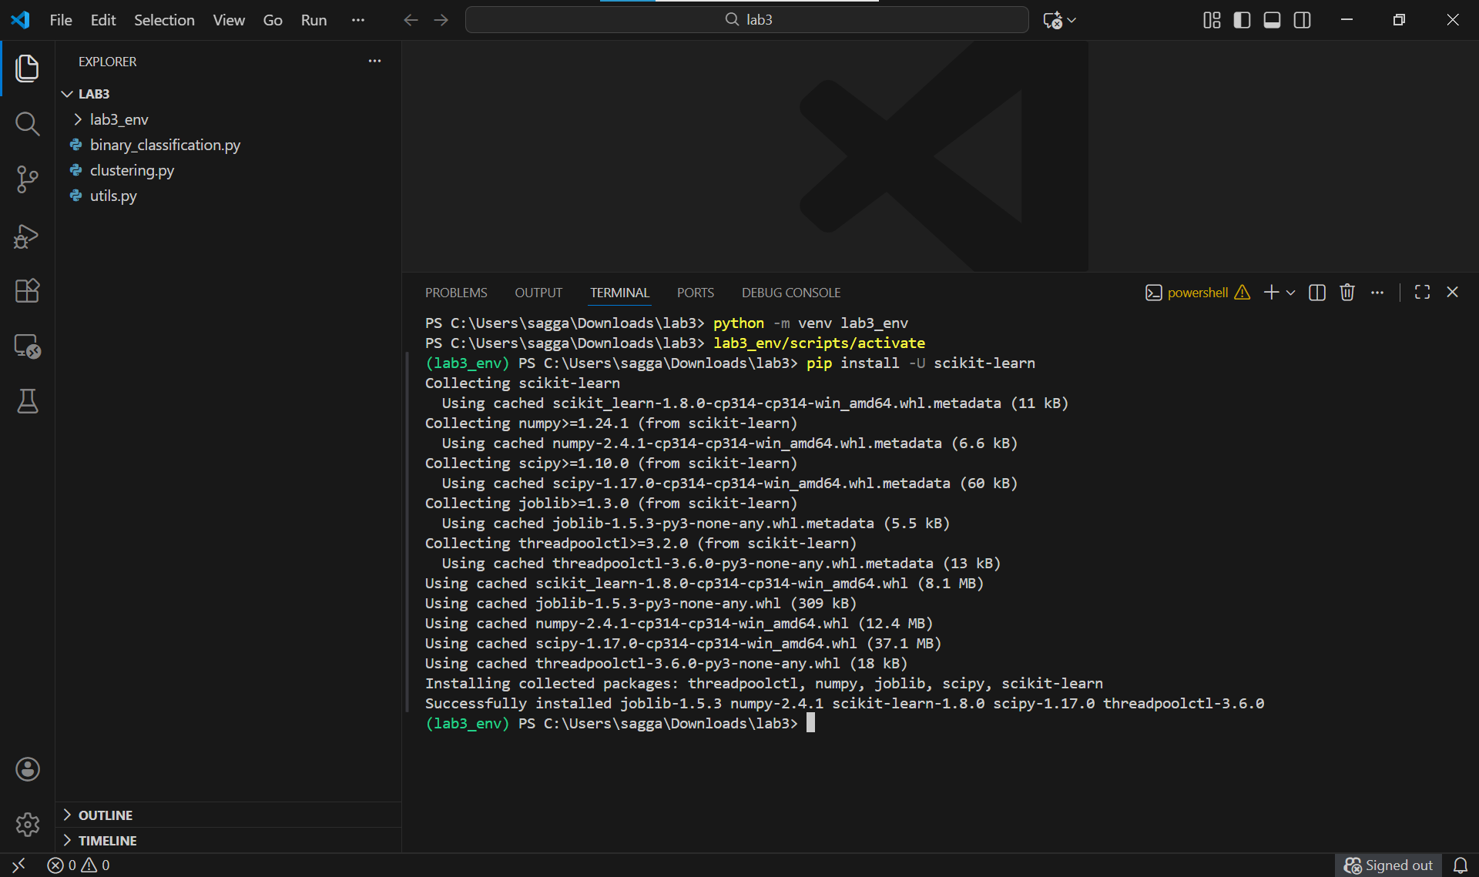

Slide 34
Step 3
Run the command:
python binary_classification.py
This command conducts supervised learning by:
Scale the features.
Split the data into training and testing sets.
Train a Random Forest model on the training set to solve a binary classification task – classifying samples whether they are cancerous or not.
Measure the model’s performance on the testing set using F1 score.

Slide 35
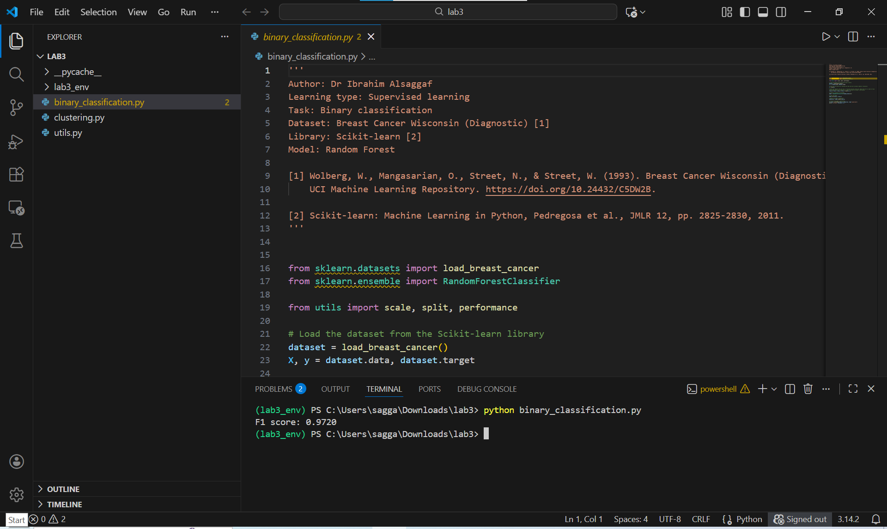

Slide 36
Step 4
Run the command:
python clustering.py
This command conducts unsupervised learning by:
Scale the features.
Split the data into training and testing sets.
Train a K-Means model on the training set to cluster samples into two groups (cancerous and non- cancerous).
Measure the model’s performance on the testing set using Adjusted Rand Index (ARI) score.

Slide 37
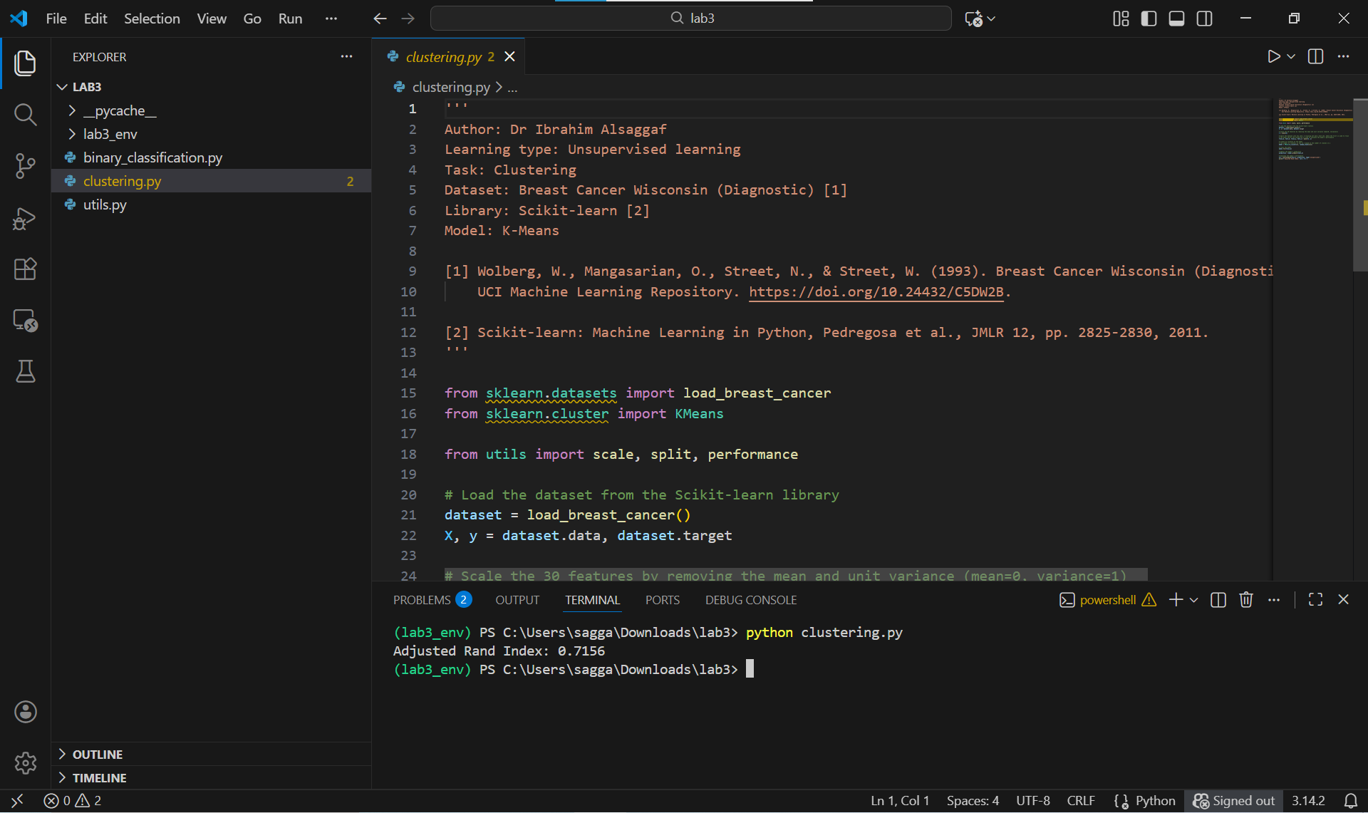

Slide 38


Lab 3: Implementing two types of learning
Congrats!
[ ] Implement a simple supervised learning task (Binary classification)
[ ] Implement a simple unsupervised learning task (Clustering)

Slide 39
Quiz 2

Slide 40
Q1: What is the main difference between self-supervised learning and supervised learning?
Self-supervised learning uses reinforcement signals from the environment, while supervised learning uses labelled datasets
Self-supervised learning only requires small datasets, while supervised learning requires large datasets
Self-supervised learning is only used in robotics, while supervised learning is used in several domains, such as computer vision
Self-supervised learning generates labels automatically from the dataset itself, while supervised learning requires manually labelled data provided by humans

Slide 41
Q2: In this lab, why does supervised learning achieve better performance than unsupervised learning, given that both paradigms were evaluated on the same dataset?
K-Means always performs worse because it cannot handle continuous features, whereas Random Forest can
Supervised learning algorithms use more computational power, which automatically guarantees better accuracy than unsupervised learning algorithms
Supervised learning algorithms directly learns from labelled data, optimising predictions against known outcomes, while unsupervised learning algorithms cluster based only on feature similarity without labels
K-Means produces identical clusters regardless of the dataset, so its performance is always worse than Random Forest

Slide 42
Reading list
Random Forest simple explanation
https://williamkoehrsen.medium.com/random-forest-simple-explanation-377895a60d2d
K-Means Clustering explained
https://towardsdatascience.com/k-means-clustering-explained-4528df86a120
But what is a neural network? | Deep learning chapter 1
https://www.youtube.com/watch?v=aircAruvnKk

